Slide 1
FINLATICS DATA SCIENCE CASE PROJECT
-ULLAS G

Slide 2
Topic: Banking
PROBLEM STATEMENT:
The goal of this data science project is to analyze and predict client behavior in a banking dataset related to direct marketing campaigns. Specifically, the objective is to explore correlations and patterns among various client attributes and determine the likelihood of clients subscribing to a term deposit

Slide 3
Python Libraries used:
1) Matplotlib – Version: 3.9.0
2) Seaborn – Version: 0.13.2
3) Pandas - Version: 2.2.2
4) Numpy – Version: 1.26.4

Slide 4
Key Insights from the Analysis

Slide 5
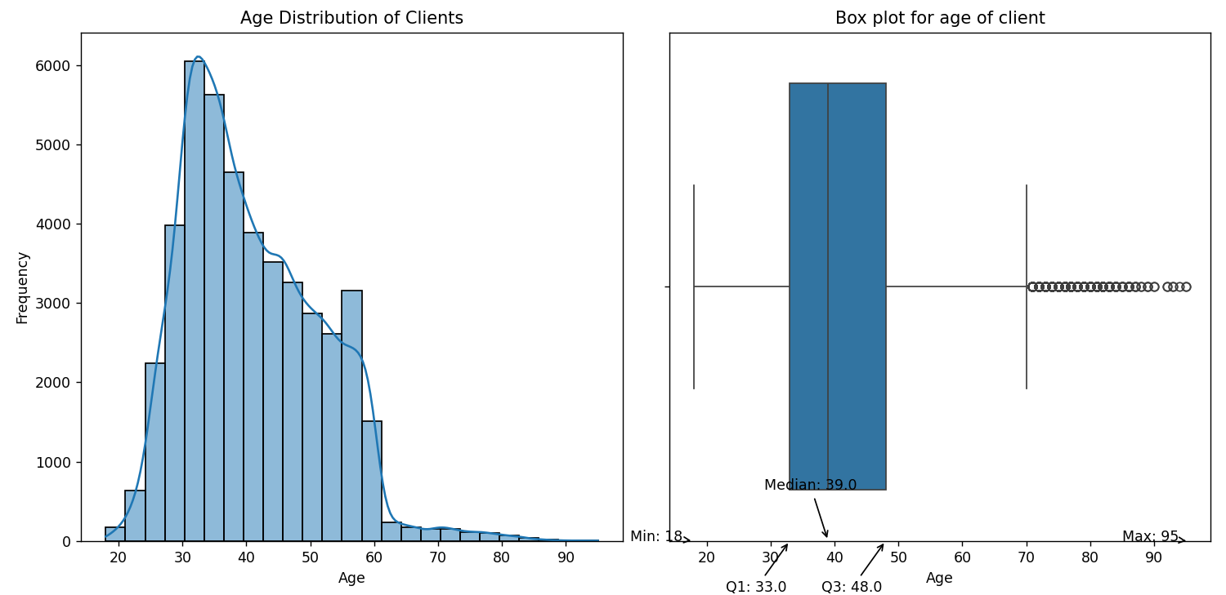
Age Distribution Analysis of Clients

Slide 6
Age Distribution Analysis of Clients
The age distribution of clients is shown through a histogram and a box plot. The histogram indicates that the majority of clients are between 30 and 40 years old. The box plot reveals the median age to be around 39 years, with an interquartile range from 33 to 48 years. The minimum age is 18 and the maximum age observed is 95, with some outliers in the older age range.

Slide 7
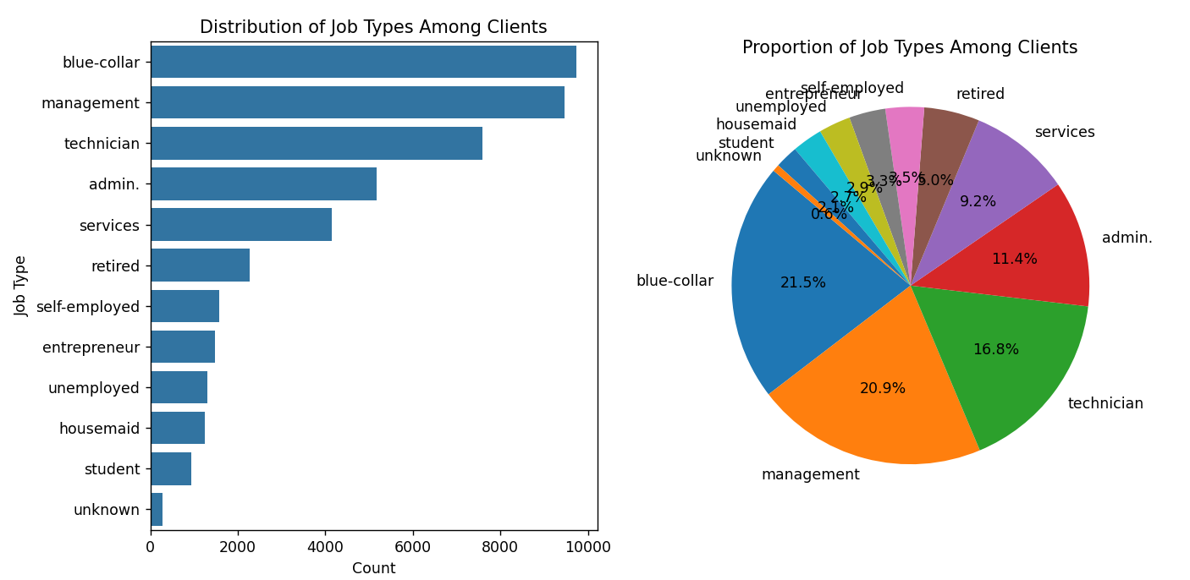
Distribution of Job Types Among Clients

Slide 8
Distribution of Job Types Among Clients
The analysis of job types among the clients reveals that the most common job categories are "blue-collar“, "management" and "technician" collectively accounting for over half of the clients. This suggests that the majority of the clients work in manual labor, managerial, or technical roles. The distribution and proportion charts effectively illustrate the varying representation of each job type in the dataset.

Slide 9
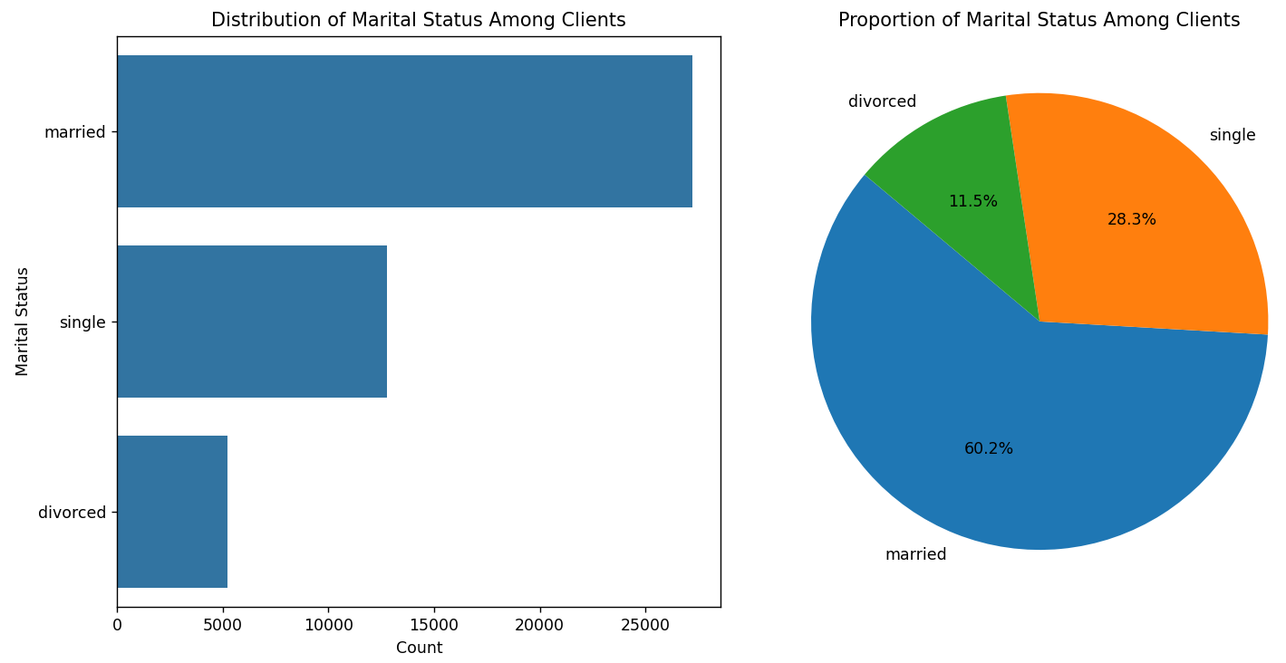
Distribution of Client Marital Status
The distribution shows that
Around 60.2% of the clients are
Married,28.3 % are single and
11.5% are divorced

Slide 10
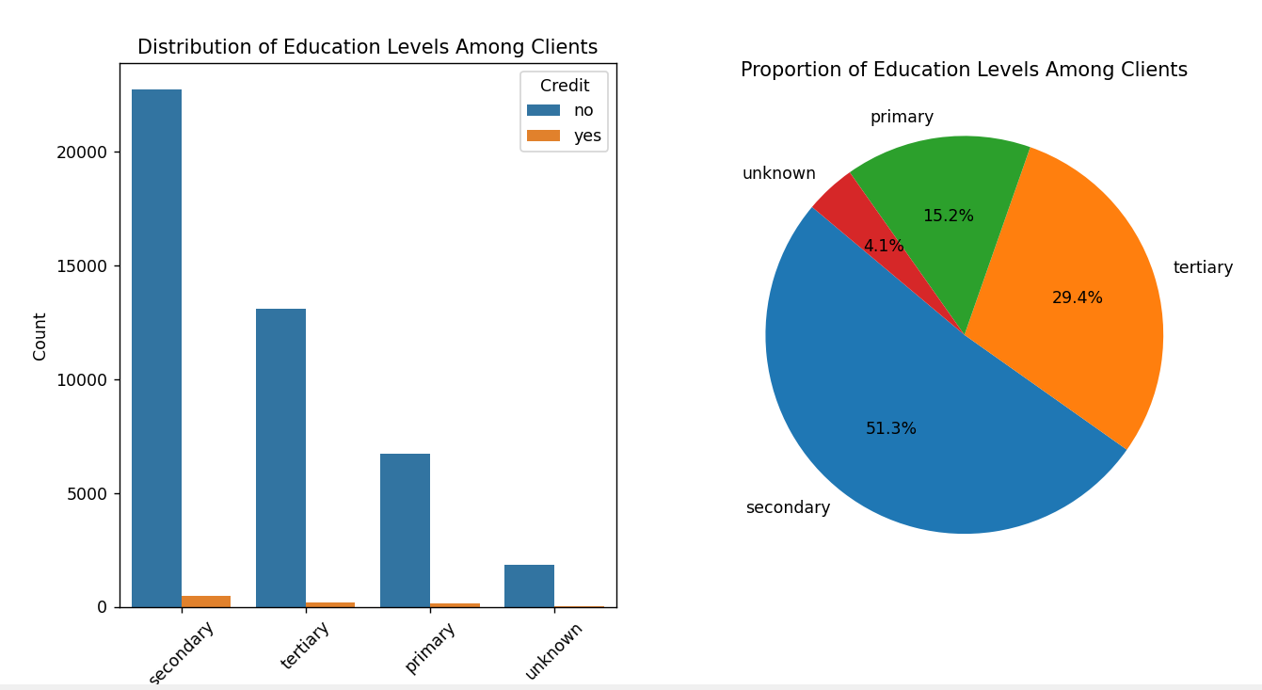
Educational Background of Clients

Slide 11
Educational Background of Clients
The education level among clients shows a diverse distribution. A pie chart reveals that 51.3% have secondary education, 15.2% primary, and 29.2% tertiary. An additional 4.1% have unknown education levels. A bar plot further illustrates these differences, comparing clients with and without credit

Slide 12
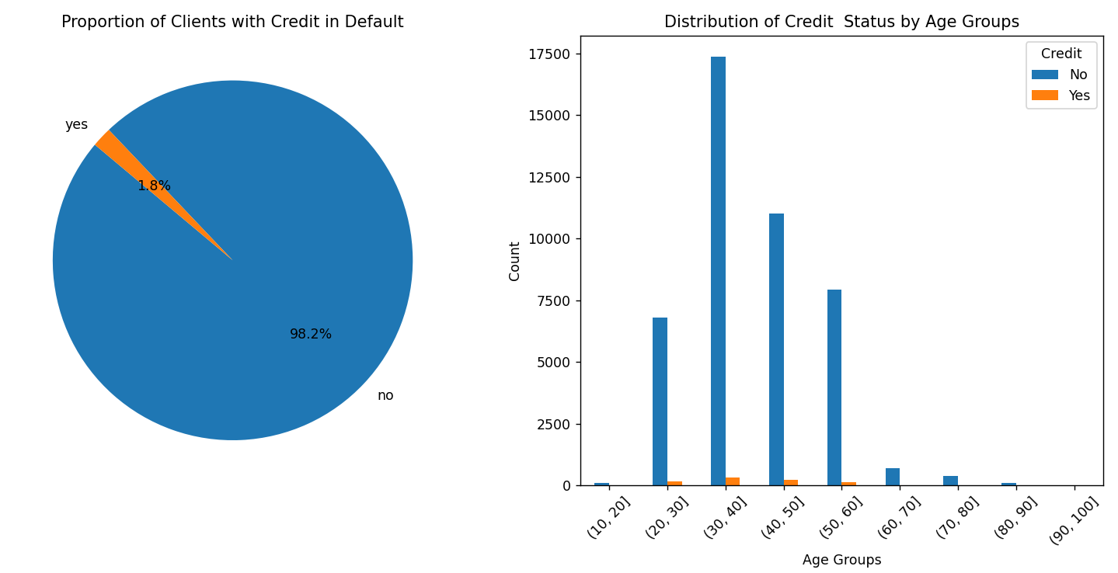
Proportion of Clients with Credit in Default
Only 1.8% of the clients have credit
in default. The bar plot shows the distribution of credit status by age groups. We can see that most of the clients who have credit are from the age group 30-50, while some of
Them are from 20-30 and 50-60

Slide 13
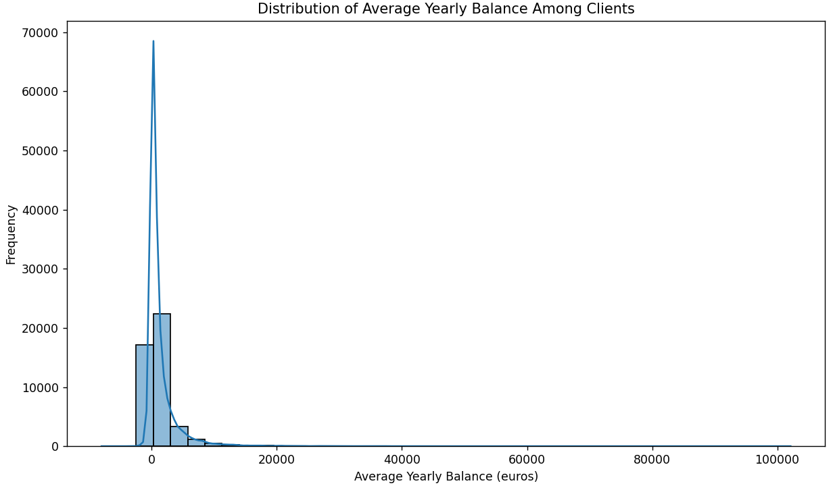
Distribution of Average Yearly Balance Among Clients
The distribution of average yearly balances is highly right-skewed. Most clients have balances between 0 and 20,000 euros, with a large concentration near the lower end. A few clients have significantly higher balances, creating a long tail to the right.

Slide 14
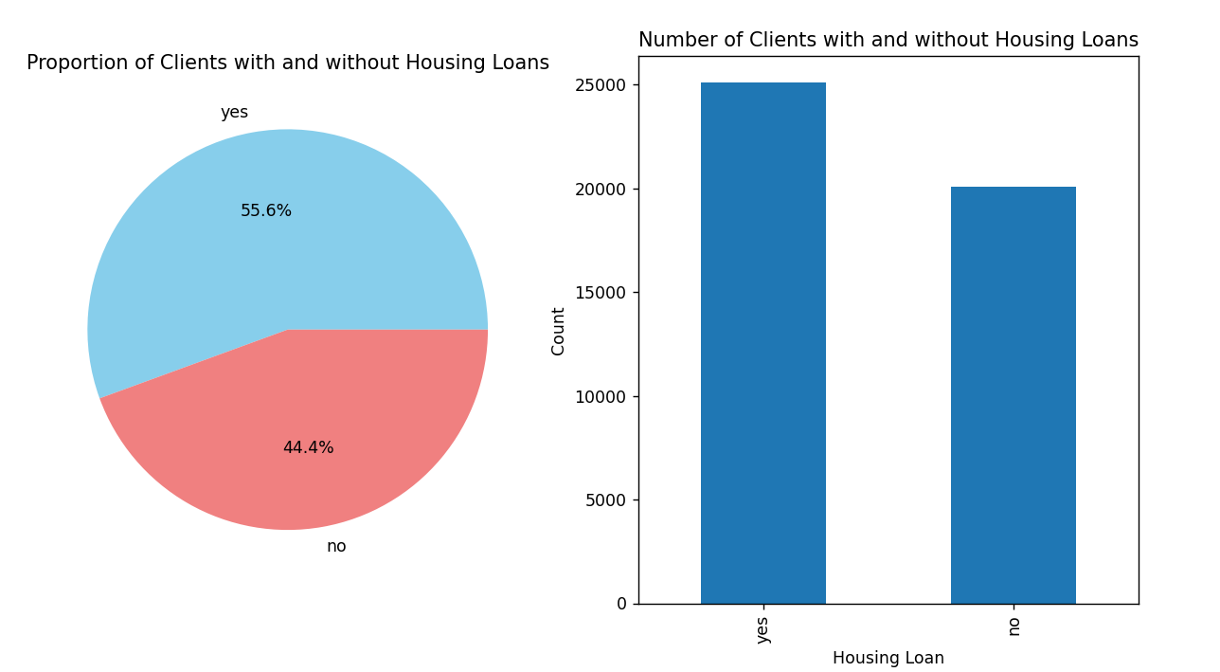
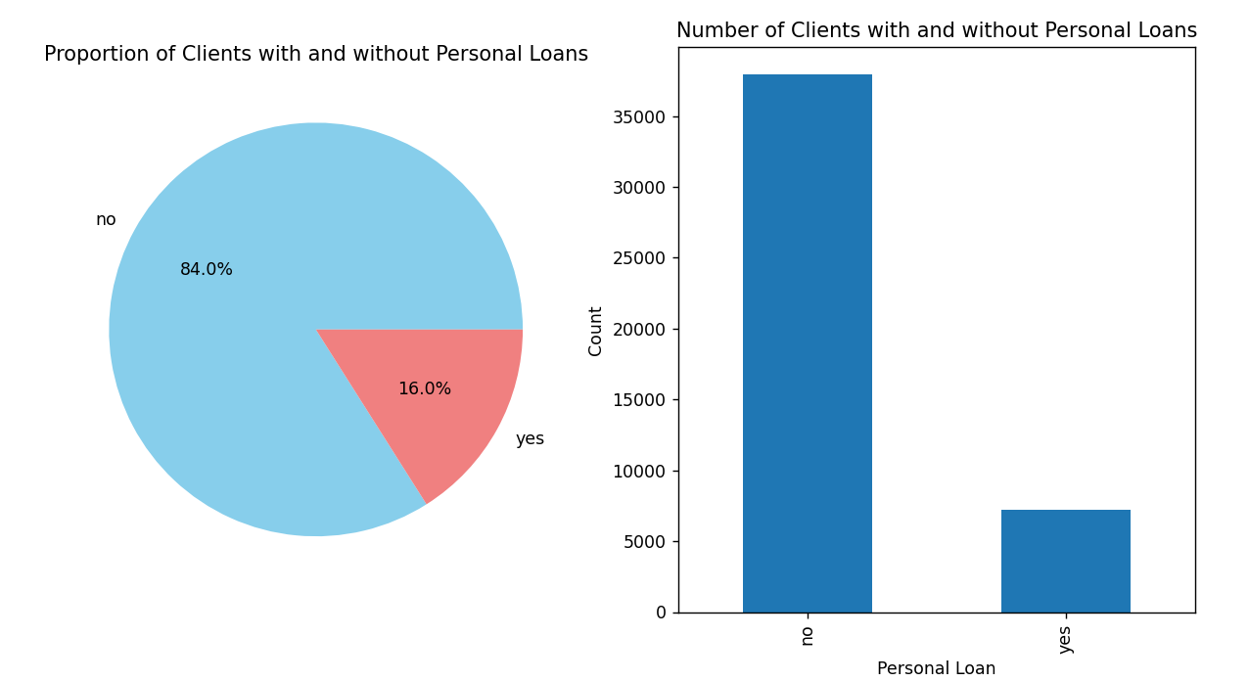
Clients with Housing and Personal Loans
The above plots depict the percentage of clients with housing and personal loans.
Out of 45216 clients , 7244 of them have personal loans and 25130 of them have housing loans .

Slide 15
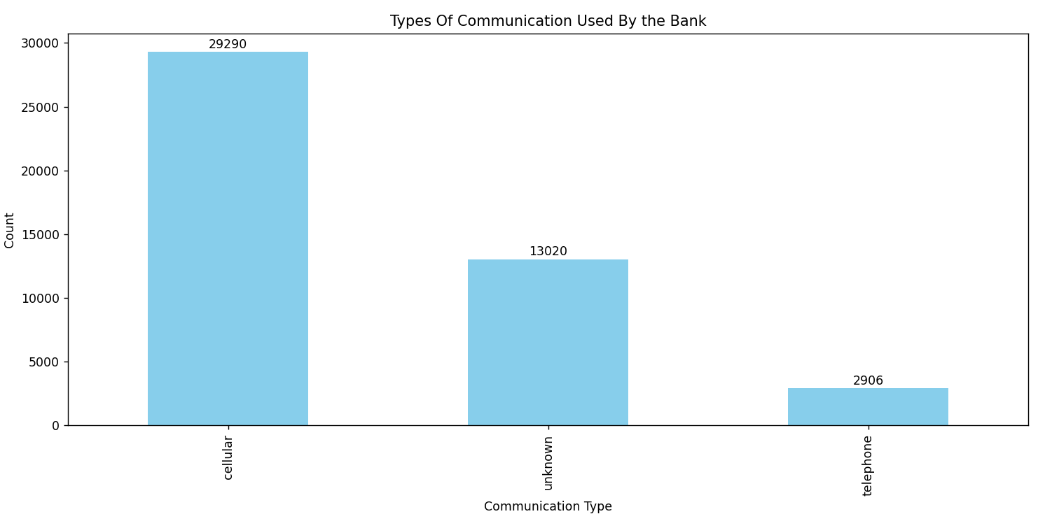
Communication Types Used During the Campaign
During the campaign, the bank employed different communication methods to reach out to clients. The majority of contacts, totaling 29,290, were made through cellular communication, suggesting a preference for mobile-based outreach. Additionally, 2,906 contacts were conducted via telephone. 13,020 contacts had an unknown communication type, indicating a need for better tracking of communication channels. This distribution underscores the importance of optimizing communication strategies to enhance client engagement and campaign effectiveness.

Slide 16
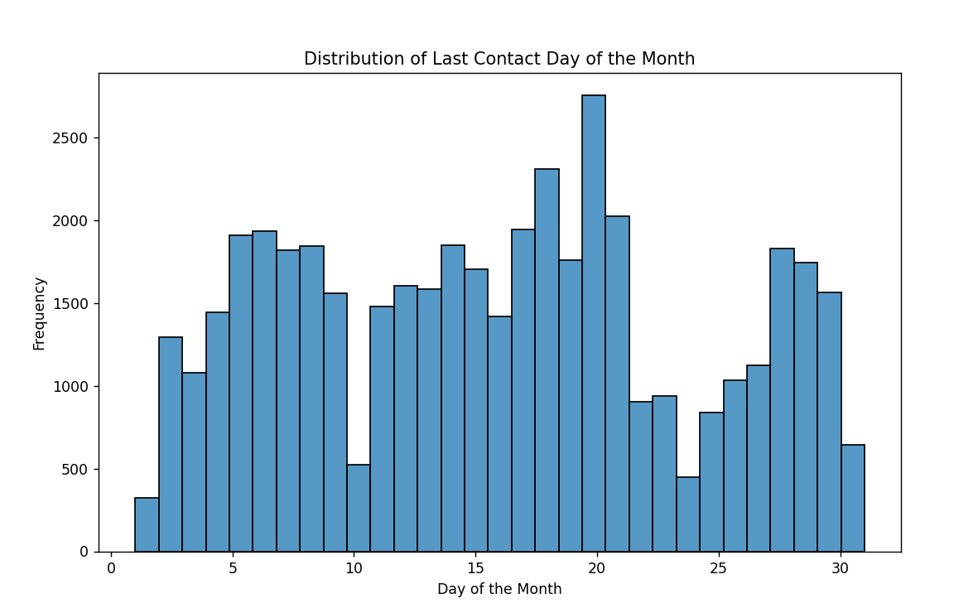
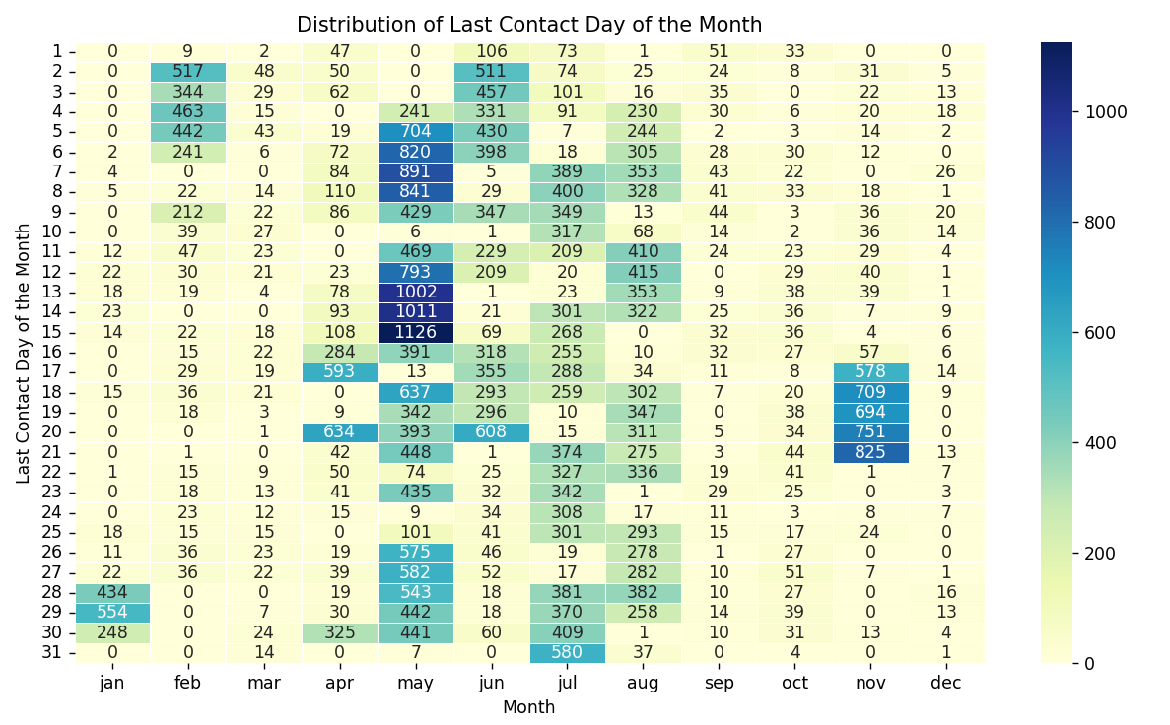
Distribution of Last contact day of the month

Slide 17
Distribution of Last contact day of the month
The bar plot reveals that the 20th day of the month recorded the highest number of client contacts.
On the right side, the heatmap displays the distribution of last contacts made to clients, with lighter colors indicating fewer contacts and darker colors indicating higher numbers.
Notably, the heatmap shows that May 15th had the highest number of last contacts, reaching 1,126 clients, making it a peak day for client interaction

Slide 18
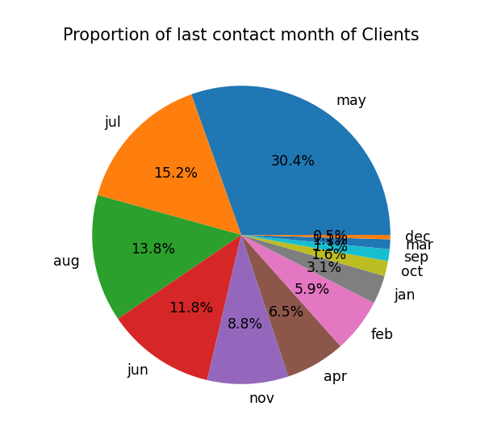
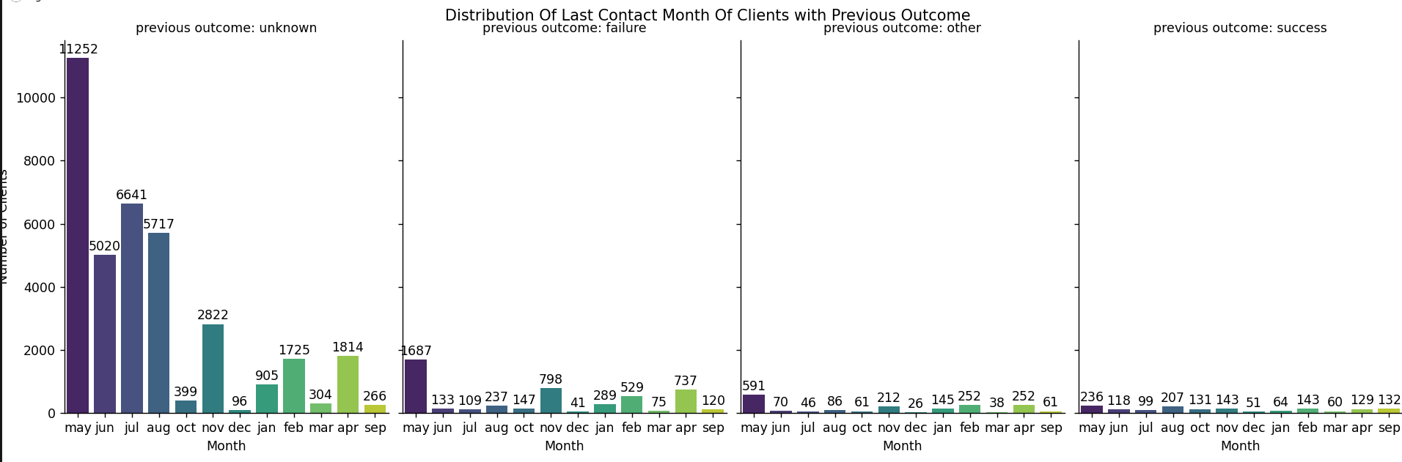
Distribution of Last contact Month

Slide 19
Distribution of Last contact Month
The pie chart illustrates the distribution of last contact months among clients, with May representing the highest proportion at 30.4% and December the lowest at 0.5%.
The accompanying bar plot displays how each month correlates with the previous outcome of client interactions, providing further insights into the effectiveness of different contact periods.

Slide 20
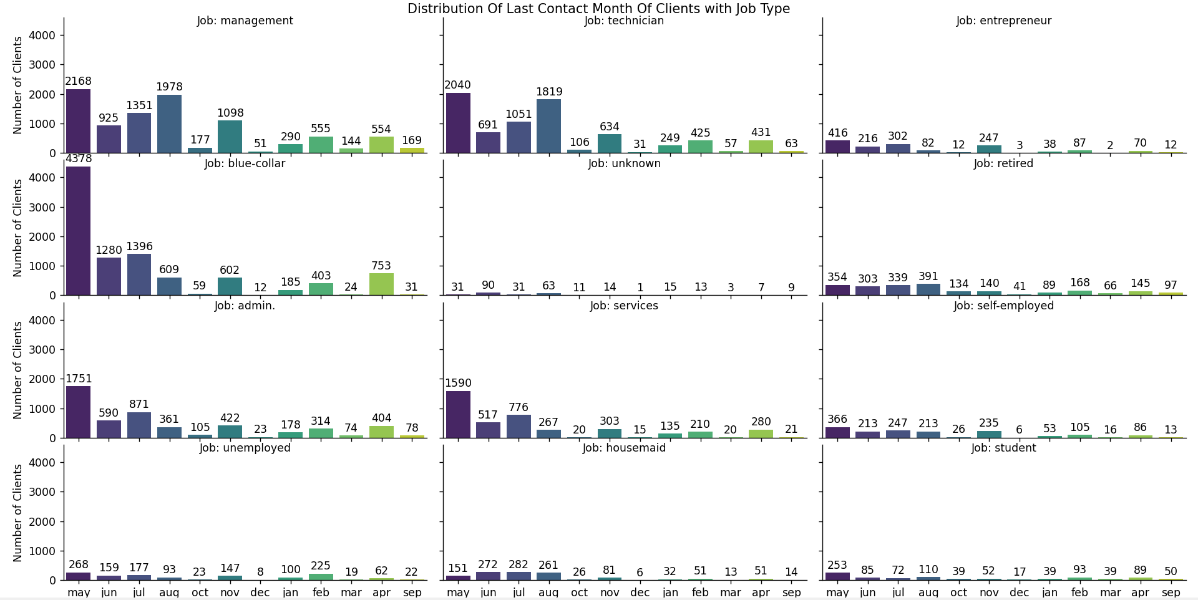
Last Contact Month vs Job Type

Slide 21
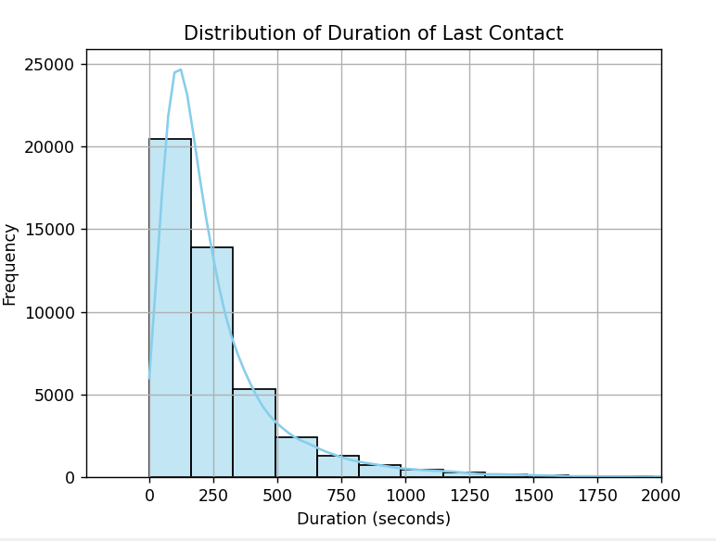
Distribution Of Duration Of Last Contact
From the plot, it's evident that the duration of the last contact for most clients ranged from 0 to 300 seconds, showing a right-skewed distribution. While some calls lasted between 500 and 800 seconds, very few exceeded 1000 seconds.

Slide 22
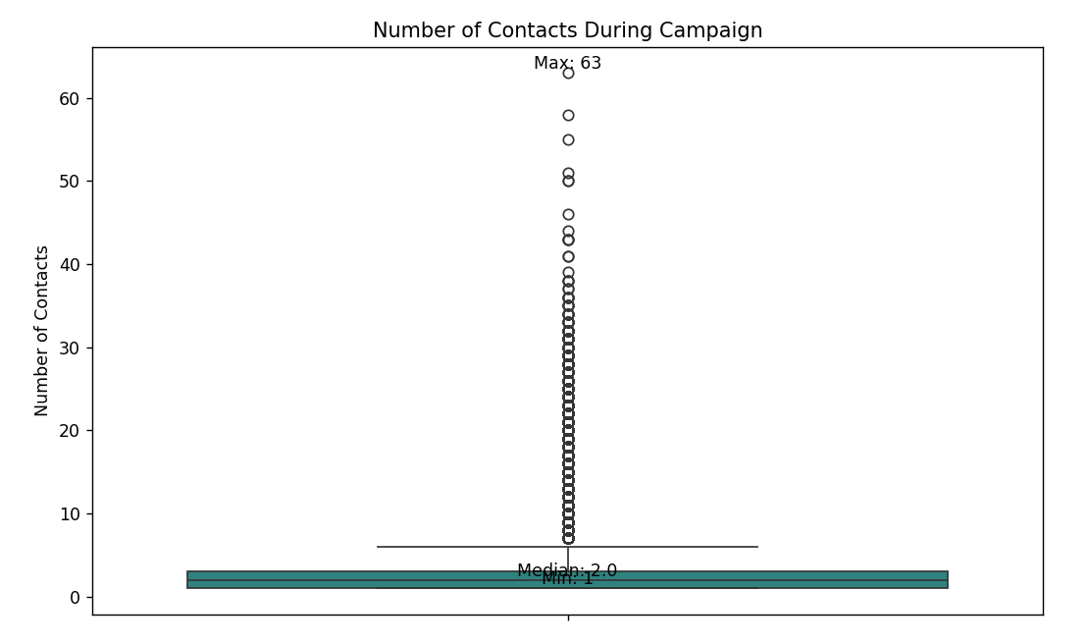
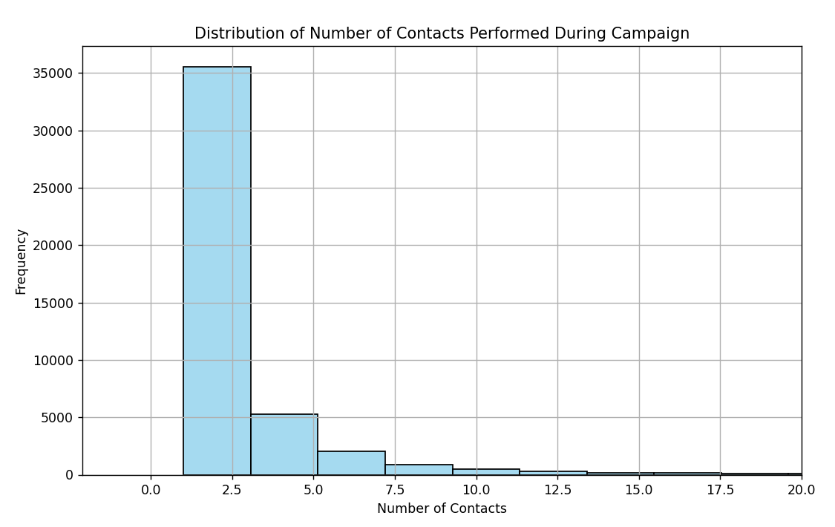
Number of Contacts Performed per Client During the Campaign

Slide 23
Number of Contacts Performed per Client During the Campaign
From the box plot on the left, we observe that the maximum number of contacts made per client during the campaign is 63, while the minimum is 1. The median number of contacts is 2, indicating that half of the clients were contacted at least twice. On average, each client received around 3 calls.
The histogram on the right shows the distribution of the number of contacts versus frequency, providing a visual representation of how many clients received different numbers of contacts during the campaign.

Slide 24
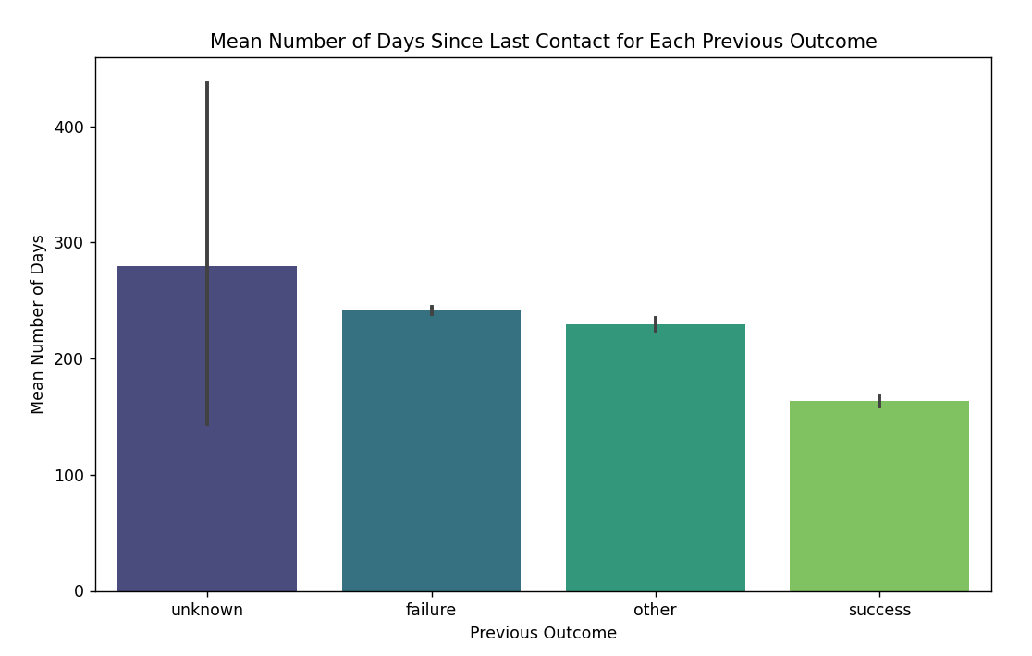
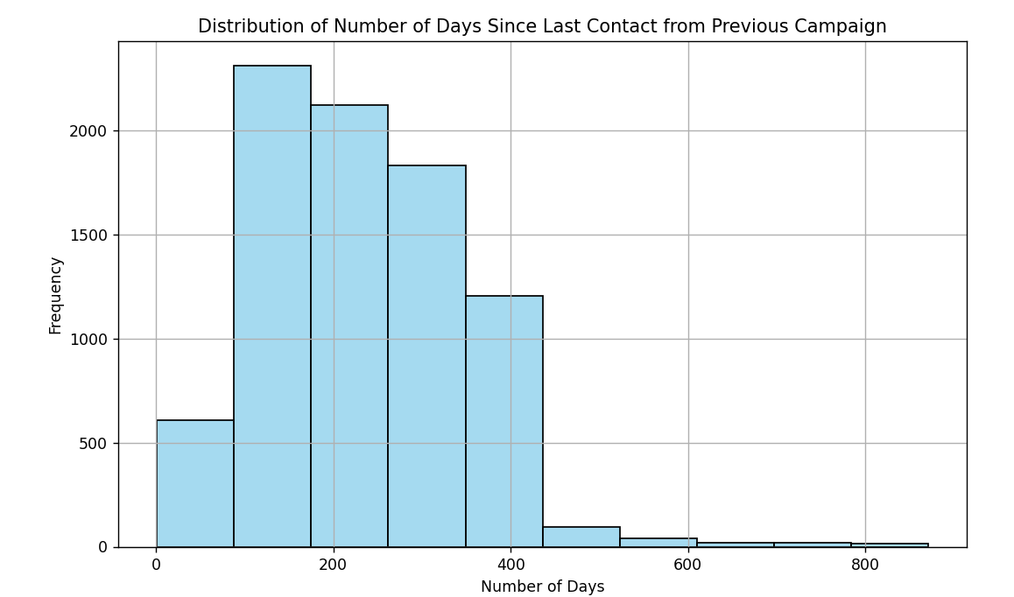
Distribution of Days Since Last Contact from Previous Campaign

Slide 25
Distribution of Days Since Last Contact from Previous Campaign
The bar plot on the left illustrates how the number of days since the last contact from the previous campaign varies according to the outcome of that campaign. While many outcomes are unknown, the known outcomes show that clients with a successful previous outcome were contacted again within a shorter timeframe compared to those with a failed outcome.
The histogram on the right displays the distribution of days since the last contact from the previous campaign. A noticeable peak can be observed in the 100-200 day range.

Slide 26
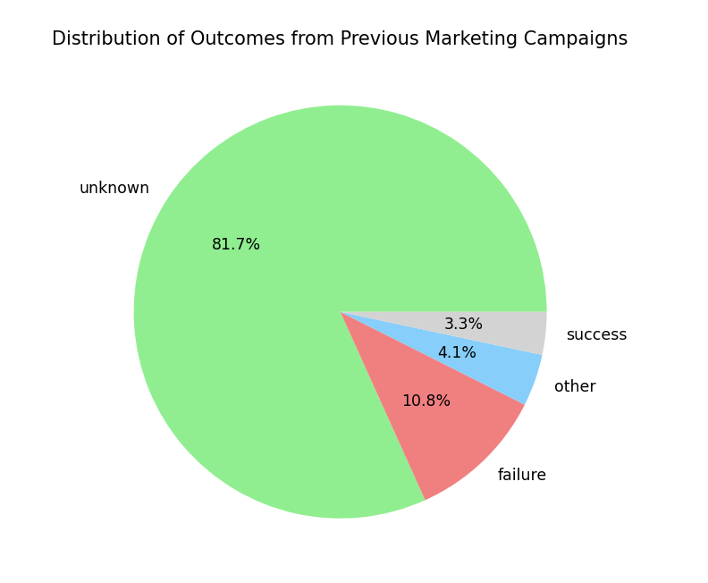
Outcomes of Previous Marketing Campaigns
From the pie chart, it is evident that the success rate of the previous campaign was 3.3%, while the failure rate was 10.8%. A significant portion of the outcomes is categorized as unknown, suggesting the need for improved data tracking processes.

Slide 27
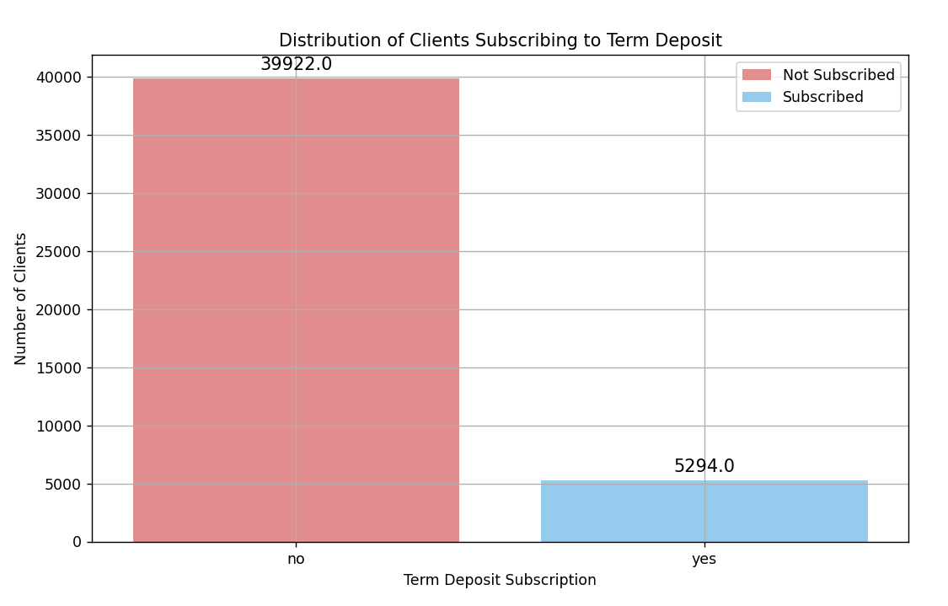
Distribution of Term Deposit Subscriptions
A total of 5294 clients subscribed to term deposit, while the remaining 39922 clients did not subscribe to term deposit
Percentage subscribed to term deposit: 11.7%
Percentage not subscribed to term deposit: 88.3%

Slide 28
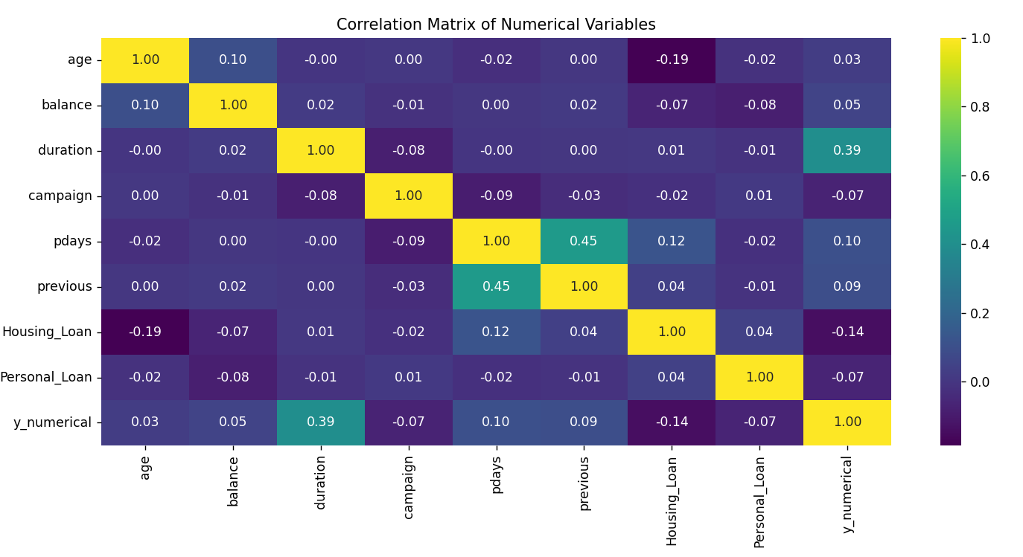
Correlations Between Numerical Attributes and Likelihood of Subscribing to a Term Deposit

Slide 29
Correlations Between Numerical Attributes and Likelihood of Subscribing to a Term Deposit
The heatmap displays correlations between all numerical attributes and the target variable (y_numerical). Housing_loan and Personal_Loan, originally categorical, have been converted to numerical attributes where 1 represents "yes" and 0 represents "no".
Summary Of the logically drawn results of correlation Statistics of Numerical variables with the target variable 'y'
Variable Correlation_Coefficient
Housing_Loan -0.14
Personal_Loan -0.07
age 0.03
balance 0.05
duration 0.39
The correlation coefficients for housing loan and personal loan with y, is negative inferring that clients with housing or personal loans did not want to subscribe to the term deposit
The correlation coefficients for age and balance with y is slightly positive , inferring that there is a weak linear relationship between them and the target y. This seems logical as greater the balance ,higher is the chance of subscribing to a deposit
The correlation coefficient between duration and y is a moderate positive value(0.39), inferring that longer the duration of last contact, greater is the chance of subscribing to the term deposit.

Slide 30
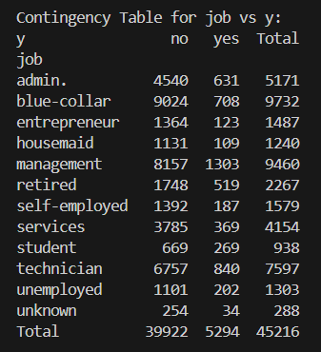
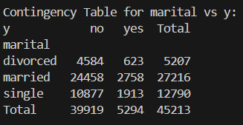
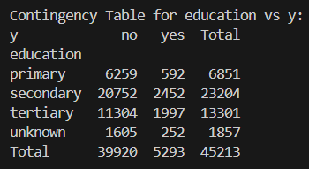
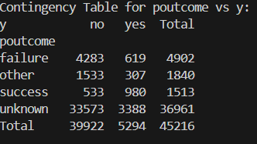
Relationship Between Categorical Attributes and Term Deposit Subscription (y)
Job vs ‘y’
Marital vs ‘y’
Education vs ‘y’
Poutcome vs’y’ ‘y’

Slide 31
Relationship Between Categorical Attributes and Term Deposit Subscription (y)
The contingency tables above shows different values of the respective categorical variables and the value of the target variable ‘y’ for those values. From these tables we can learn about the behaviour of these categorical variables with the target variable ‘y’

